Slide 1
Pretty Aesthetic Notes for School Infographics
Here is where this template begins

Slide 2
About Pretty Aesthetic Notes for School Infographics
This template contains an assortment of complementary infographic resources for the Pretty Aesthetic Notes for School presentation.
These infographics are adapted to the style of the aforementioned presentation, so you can insert them easily and have them completely integrated at once. You just need to do the following:
Select the element that you want to copy
Right-click and choose “Copy”
Go to the slide where you want the element to appear
Right-click and choose “Paste”

Slide 3
Pretty aesthetic notes for school infographics
School grades
 | English | Math | Art | Music
Jenna Doe | 08 | 07 | 09 | 10
Timmy Jimmy | 05 | 09 | 07 | 09
Susan Bones | 10 | 10 | 08 | 07
John Green | 09 | 07 | 05 | 09
David James | 09 | 05 | 06 | 08
Sophia Brown | 07 | 09 | 08 | 10

Slide 4
Pretty aesthetic notes for school infographics
Our teaching process
Step 1
Mercury is the closest planet to the Sun and the smallest one in the Solar System
Step 2
Jupiter was named after the Roman god of the skies and lightning
Step 3
Venus is terribly hot, even hotter than Mercury, and its atmosphere is poisonous

Slide 5
Pretty aesthetic notes for school infographics
Mercury
This planet's name has nothing to do with the liquid metal, since Mercury was named after the Roman messenger god
Jupiter
Venus
Neptune
Jupiter is the biggest planet of them all
Venus is the second planet from the Sun
It’s the farthest planet from the Sun

Slide 6
Pretty aesthetic notes for school infographics
School statistic notes
Venus
75%
Venus is the second planet from the Sun
Jupiter
50%
Jupiter is the biggest planet of them all

Slide 7
Pretty aesthetic notes for school infographics
Mars
Neptune
Despite being red, Mars is a cold place
It’s the farthest planet from the Sun
Venus
Saturn
Venus has a beautiful name and is the second planet from the Sun. It’s hot, and its atmosphere is extremely poisonous
Saturn was named after a Roman god
Jupiter
Mercury
Jupiter is the biggest planet of them all
It’s the closest planet to the Sun

Slide 8
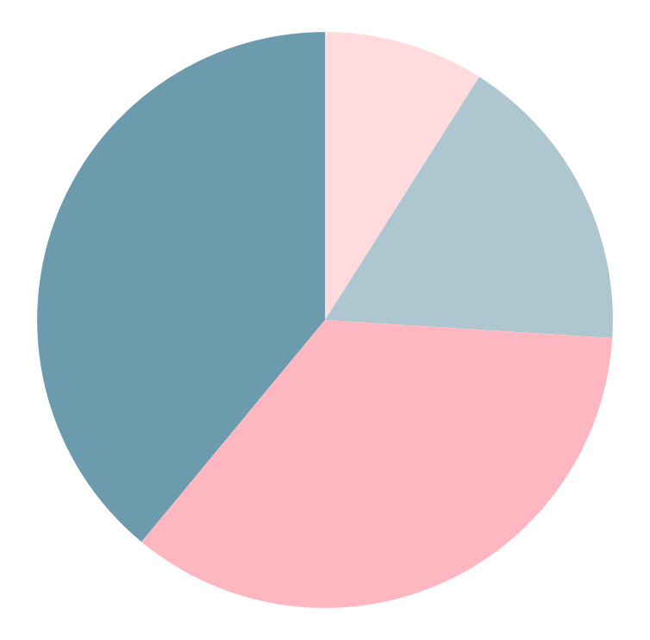
Pretty aesthetic notes for school infographics
9%
35%
Jupiter
Neptune
Jupiter is the biggest planet of them all
It’s the farthest planet from the Sun
17%
39%
Saturn
Venus
Saturn was named after a Roman god
Follow the link in the graph to modify its data and then paste the new one here. For more info, click here
Venus is the second planet from the Sun

Slide 9
Pretty aesthetic notes for school infographics
Problem
Despite being red, Mars is a cold place
Answer
01
Needed
Saturn was named after a Roman god
02
05
Venus is the second planet from the Sun
Not needed
Math
03
04
Mercury is the smallest planet
Neptune is very far away from us

Slide 10
Pretty aesthetic notes for school infographics
What to do | What not to do
You can list the things you should do here | You can list the things you shouldn’t do here
You can list the things you should do here | You can list the things you shouldn’t do here
You can list the things you should do here | You can list the things you shouldn’t do here
You can list the things you should do here | You can list the things you shouldn’t do here

Slide 11
Pretty aesthetic notes for school infographics
Cause and effect
Causes
Situation
Effects
Venus has a beautiful name and is the second planet from the Sun
Saturn is a gas giant and has several rings. It's composed mostly of hydrogen and helium. It was named after the Roman god of wealth
Jupiter is a gas giant and the biggest planet in the Solar System
Mars is full of iron oxide dust, which gives the planet its reddish cast
Neptune is the fourth-largest planet in the Solar System

Slide 12
Pretty aesthetic notes for school infographics
Pluto
Venus
01
08
Pluto is a dwarf planet
Venus has a beautiful name
Mercury
02
07
Earth
Mercury is a small planet
Earth is the planet with life
Jupiter
03
06
Mars
Jupiter is the biggest planet
Mars is a cold place
Neptune
04
05
Saturn
Neptune is far away from us
Saturn is the ringed planet

Slide 13
Pretty aesthetic notes for school infographics
Neptune is the farthest planet from the Sun
Jupiter is the biggest planet of them all
Venus is the second planet from the Sun
Title
Mercury is the closest planet to the Sun
Saturn was named after a Roman god
Despite being red, Mars is actually a cold place

Slide 14
Pretty aesthetic notes for school infographics
Definition
Characteristics
Venus is the second planet from the Sun
Despite being red, Mars is actually a cold place
Title
Examples
Non-examples
Jupiter is a gas giant and the biggest planet
Saturn is composed of hydrogen and helium

Slide 15
Pretty aesthetic notes for school infographics
Topic sentence
The Sun is the star at the center of the Solar System
Earth is the third planet from the Sun and the only one that harbors life in the Solar System
Venus is the second-brightest natural object in the night sky after the Moon
Details
Closing sentence
Neptune is the fourth-largest planet in the Solar System

Slide 16
Pretty aesthetic notes for school infographics
Tell the story
Saturn is a gas giant and has several rings. It's composed mostly of hydrogen and helium. It was named after the Roman god of wealth
First
Despite being red, Mars is actually a cold place. It's full of iron oxide dust, which gives the planet its reddish cast
Then
Earth is the third planet from the Sun and the only one that harbors life in the Solar System. This is where we all live
Last

Slide 17
Pretty aesthetic notes for school infographics
Both
Saturn is a gas giant and has several rings. It's composed mostly of hydrogen and helium. It was named after the Roman god of wealth and agriculture
Earth
Mars
Earth is the third planet from the Sun and the only one that harbors life in the Solar System. This is where we all live
Despite being red, Mars is actually a cold place. It's full of iron oxide dust, which gives the planet its reddish cast
01
03
02

Slide 18
Pretty aesthetic notes for school infographics
Title
Venus is the second planet from the Sun
Item 1
Saturn is a gas giant and has several rings. It's composed mostly of hydrogen and helium. It was named after the Roman god of wealth
Item 2
Neptune is the farthest planet from the Sun
Item 3
Jupiter is the biggest planet in the Solar System

Slide 19
Pretty aesthetic notes for school infographics
Mercury
Venus
Neptune
Mars
Mercury is the closest planet to the Sun and the smallest one in the Solar System
It’s the second-brightest natural object in the night sky after the Moon
It's also the fourth-largest planet by diameter in the Solar System
Mars is cold and full of iron oxide dust, which gives the planet its reddish cast

Slide 20
Pretty aesthetic notes for school infographics
Venus
Mars
Venus is the second planet from the Sun
Subtitle 1
Despite being red, Mars is a cold place
The Sun is the star at the center of the Solar System
Neptune
Saturn
It’s the farthest planet from the Sun
Saturn was named after a Roman god
Subtitle 2
Mercury
Earth is the only planet known to harbor life
Jupiter
It’s the closest planet to the Sun
Jupiter is the biggest planet of them all

Slide 21
Pretty aesthetic notes for school infographics
Venus
Earth
Mars
Neptune
Venus has a beautiful name
Earth is the planet with life
Mars is full of iron oxide dust
Neptune is far away from us
Jupiter
Saturn
Ceres
The Moon
It’s the biggest planet of them all
It was named after a god
It’s located in the main asteroid belt
It’s Earth’s only natural satellite

Slide 22
Pretty aesthetic notes for school infographics
Title
Who?
What?
When?
Saturn was named after a Roman god
The Moon is Earth’s only natural satellite
Jupiter is the biggest planet of them all
Where?
Why?
How?
Ceres is located in the main asteroid belt
Neptune is the farthest planet from the Sun
Despite being red, Mars is actually a cold place

Slide 23
Pretty aesthetic notes for school infographics
Venus
Venus is the second planet from the Sun
Saturn
Saturn was named after a Roman god
Neptune
It’s the farthest planet from the Sun

Slide 24
Pretty aesthetic notes for school infographics
Sun
The Sun is the star at the center of the Solar System
Venus
It’s the second-brightest natural object in the night sky after the Moon
Mercury
Mercury is the smallest planet in the Solar System
Jupiter
Jupiter is a gas giant and the biggest planet in the Solar System

Slide 25
Pretty aesthetic notes for school infographics
Classification
Type 1 | Type 2 | Type 3 | Type 4
Saturn was named after the Roman god of wealth | The Sun is the star at the center of the Solar System | Despite being red, Mars is actually a cold place | Jupiter is the biggest planet in the Solar System
Neptune is an ice giant Mars is a really cold planet | Mercury is a small planet Venus is a very hot planet | Earth is the planet with life Ceres is in an asteroid belt | Saturn is the ringed planet Pluto is a dwarf planet

Slide 26
Pretty aesthetic notes for school infographics
Then
Now
The Sun is the star at the center of the Solar System
Causes
Saturn was named after a Roman god
Jupiter is a gas giant and the biggest planet of them all
Effects
Despite being red, Mars is actually a cold place
Venus is the second planet from the Sun
Obstacles
Neptune is the farthest planet from the Sun

Slide 27
Pretty aesthetic notes for school infographics
Neptune
It’s the farthest planet from the Sun
Venus
Jupiter
Venus is the second planet from the Sun
Jupiter is the biggest planet of them all
Saturn
Mercury
Saturn was named after a Roman god
It’s the closest planet to the Sun

Slide 28
Pretty aesthetic notes for school infographics
Monthly calendar
Mo | Tu | We | Th | Fr | Sa | Su
 |  | 01 | 02 | 03 | 04 | 05
06 | 07 | 08 | 09 | 10 | 11 | 12
13 | 14 | 15 | 16 | 17 | 18 | 19
20 | 21 | 22 | 23 | 24 | 25 | 26
27 | 28 | 29 | 30
Notes
Mercury is a small planet
Jupiter is a very big planet
Classes
Practices
Final exam

Slide 29
Pretty aesthetic notes for school infographics
Mars
Venus
Despite being red, it’s a cold place
Venus is the second planet from the Sun
Saturn
Neptune
Saturn is a gas giant and has several rings
It’s the farthest planet from the Sun

Slide 30
Pretty aesthetic notes for school infographics
Step 1
Neptune is far away from Earth
Title
Step 2
Step 3
Despite being red, Mars is a cold place
Venus is the second planet from the Sun

Slide 31
Pretty aesthetic notes for school infographics
Mars
Despite being red, Mars is a cold place
01
Venus
Venus is the second planet from the Sun
02
03
Neptune
It’s the farthest planet from the Sun
04
Jupiter
Jupiter is the biggest planet of them all

Slide 32
Pretty aesthetic notes for school infographics
Note 1
Note 3
Mars is full of iron oxide dust, which gives the planet its reddish cast
Mercury is the closest planet to the Sun and the smallest one
Note 2
Note 4
Venus has a beautiful name and is the second planet from the Sun
Jupiter is a gas giant and the biggest planet in the Solar System

Slide 33
Icon pack

Slide 34
Icon pack

Slide 35
Instructions for use
If you have a free account, in order to use this template, you must credit Slidesgo in your final presentation. Please refer to the next slide to read the instructions for premium users.
As a Free user, you are allowed to:
- Modify this template.
- Use it for both personal and commercial projects.
You are not allowed to:
- Sublicense, sell or rent any of Slidesgo Content (or a modified version of Slidesgo Content).
- Distribute Slidesgo Content unless it has been expressly authorized by Slidesgo.
- Include Slidesgo Content in an online or offline database or file.
- Offer Slidesgo templates (or modified versions of Slidesgo templates) for download.
- Acquire the copyright of Slidesgo Content.
For more information about editing slides, please read our FAQs or visit Slidesgo School:
https://slidesgo.com/faqs and https://slidesgo.com/slidesgo-school

Slide 36
Instructions for use (premium users)
As a Premium user, you can use this template without attributing Slidesgo.
You are allowed to:
Modify this template.
Use it for both personal and commercial purposes.
Share this template in an editable format with people who are not part of your team.
You are not allowed to:
Sublicense, sell or rent this Slidesgo Template (or a modified version of this Slidesgo Template).
Distribute this Slidesgo Template (or a modified version of this Slidesgo Template) or include it in a database or in any other product or service that offers downloadable images, icons or presentations that may be subject to distribution or resale.
Use any of the elements that are part of this Slidesgo Template in an isolated and separated way from this Template.
Register any of the elements that are part of this template as a trademark or logo, or register it as a work in an intellectual property registry or similar.
For more information about editing slides, please read our FAQs or visit Slidesgo School:
https://slidesgo.com/faqs and https://slidesgo.com/slidesgo-school

Slide 37
Infographics
You can add and edit some infographics to your presentation to present your data in a visual way.
Choose your favourite infographic and insert it in your presentation using Ctrl C + Ctrl V or Cmd C + Cmd V in Mac.
Select one of the parts and ungroup it by right-clicking and choosing “Ungroup”.
Change the color by clicking on the paint bucket.
Then resize the element by clicking and dragging one of the square-shaped points of its bounding box (the cursor should look like a double-headed arrow). Remember to hold Shift while dragging to keep the proportions.
Group the elements again by selecting them, right-clicking and choosing “Group”.
Repeat the steps above with the other parts and when you’re done editing, copy the end result and paste it into your presentation.
Remember to choose the “Keep source formatting” option so that it keeps the design. For more info, please visit Slidesgo School.

